Slide 1

# Code Refactoring and Bug Fixing
Prepared by Eleshala Pravalika

Slide 2
Objective of the Report:
Project Scenario
Identification of bugs
Resolving the bugs
Working code after refactoring and bug fixing.

Slide 3
Project scenario :
Note Taking Application using Python, Flask, and HTML:
The Backend development has led to challenges in making the Note Taking Application fully functional.
Refactoring the existing codebase and ensuring the proper functioning of the application.
Documenting all identified bugs during the debugging process.

Slide 4
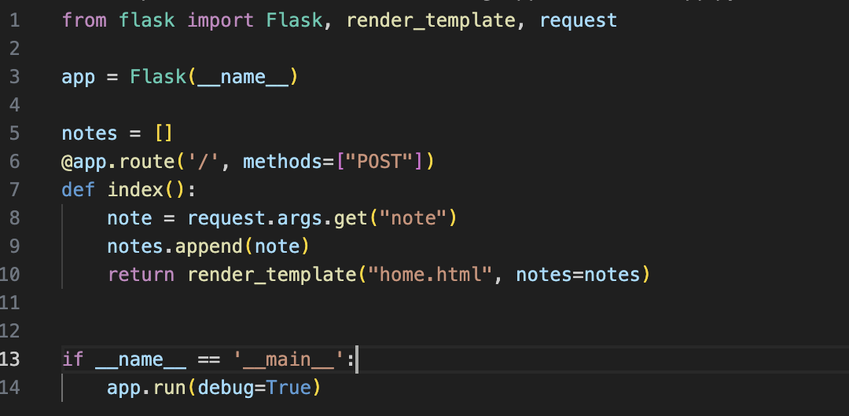
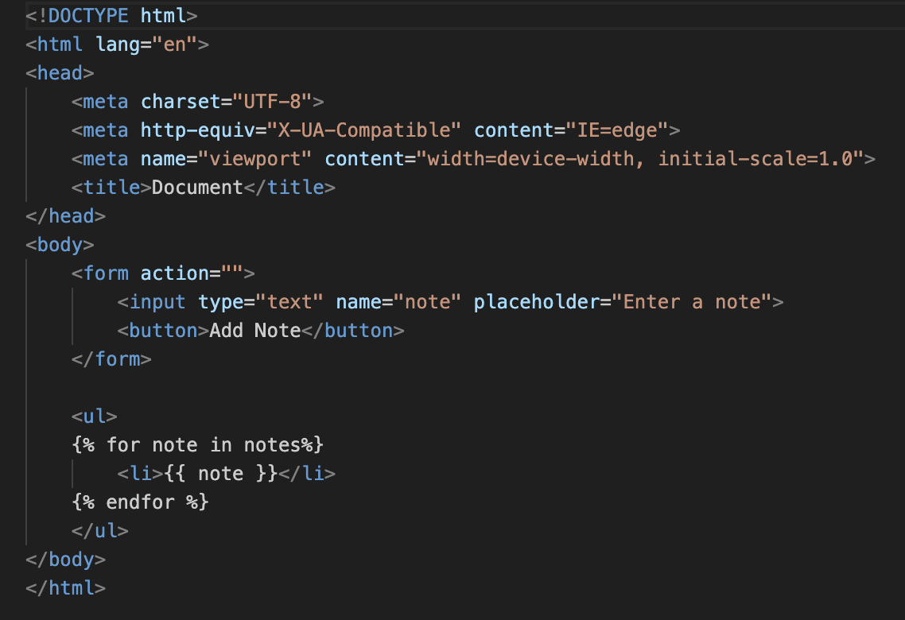
Code before bug fixing:

Slide 5
Identification of bugs:

Slide 6
Bugs in home.html:
Missing route in action.
Method attribute is missing in the form which is by default set to “GET”

Slide 7
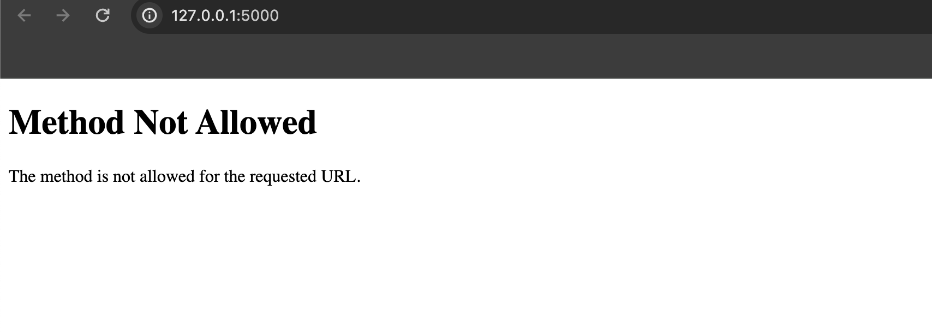
Bugs in app.py: 1. Incorrect Request method in flask
Route has only POST method ignoring the GET requests, this resulted in method not allowed error.

Slide 8
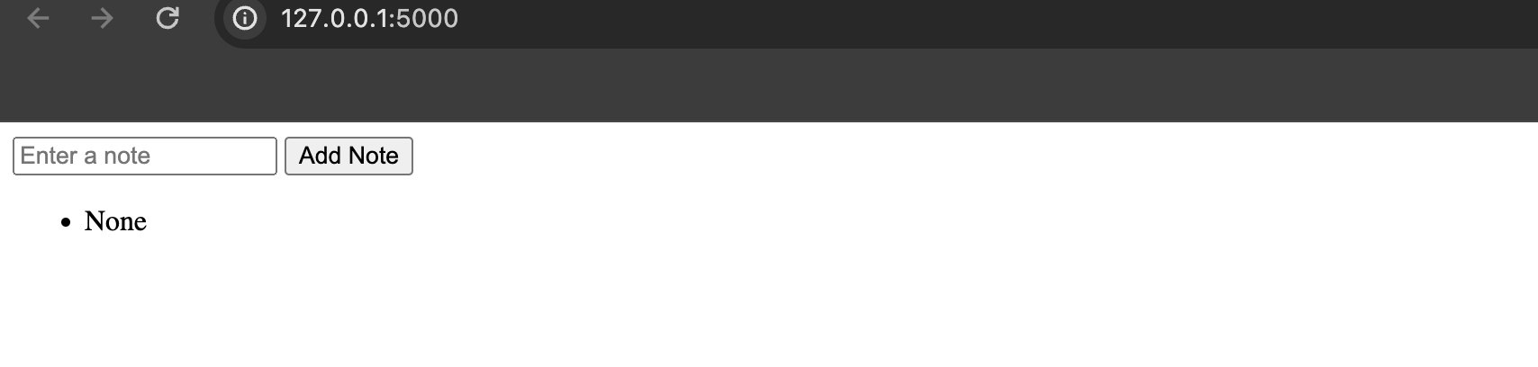
Bugs in app.py: 2. Accessing note in flask route is incorrect.
“request.args.get(“note”)” : This is used to retrieve data from GET request not for form through POST submissions. Here the data is form and not query parameters, This raises None, as form cannot be accessed through args.

Slide 9
Resolving bugs:

Slide 10
Resolving bugs in home.html:
The Form action is mentioned as “/” to access the desired route.
The Form method is updated to “post” ,This is required to handle the note additions.

Slide 11
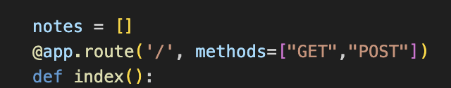
Resolving bugs in app.py:
The flask route methods are updates with both GET and POST requests i.e., methods = [“GET” , ”POST”]

Slide 12
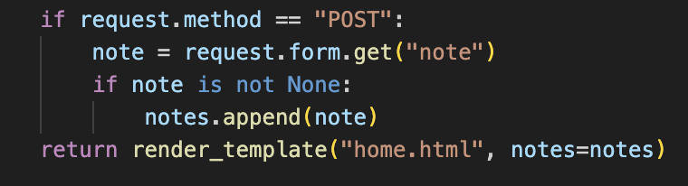
Resolving bugs in app.py:
2. “request.args.get(“note”)” : This is corrected by replacing args with form for handling the note submissions → “request.form.get(“note”)” The below code handles the none values in note and correct submissions through post method.

Slide 13
Session Management - Working code after refactoring and bug fixing

Slide 14
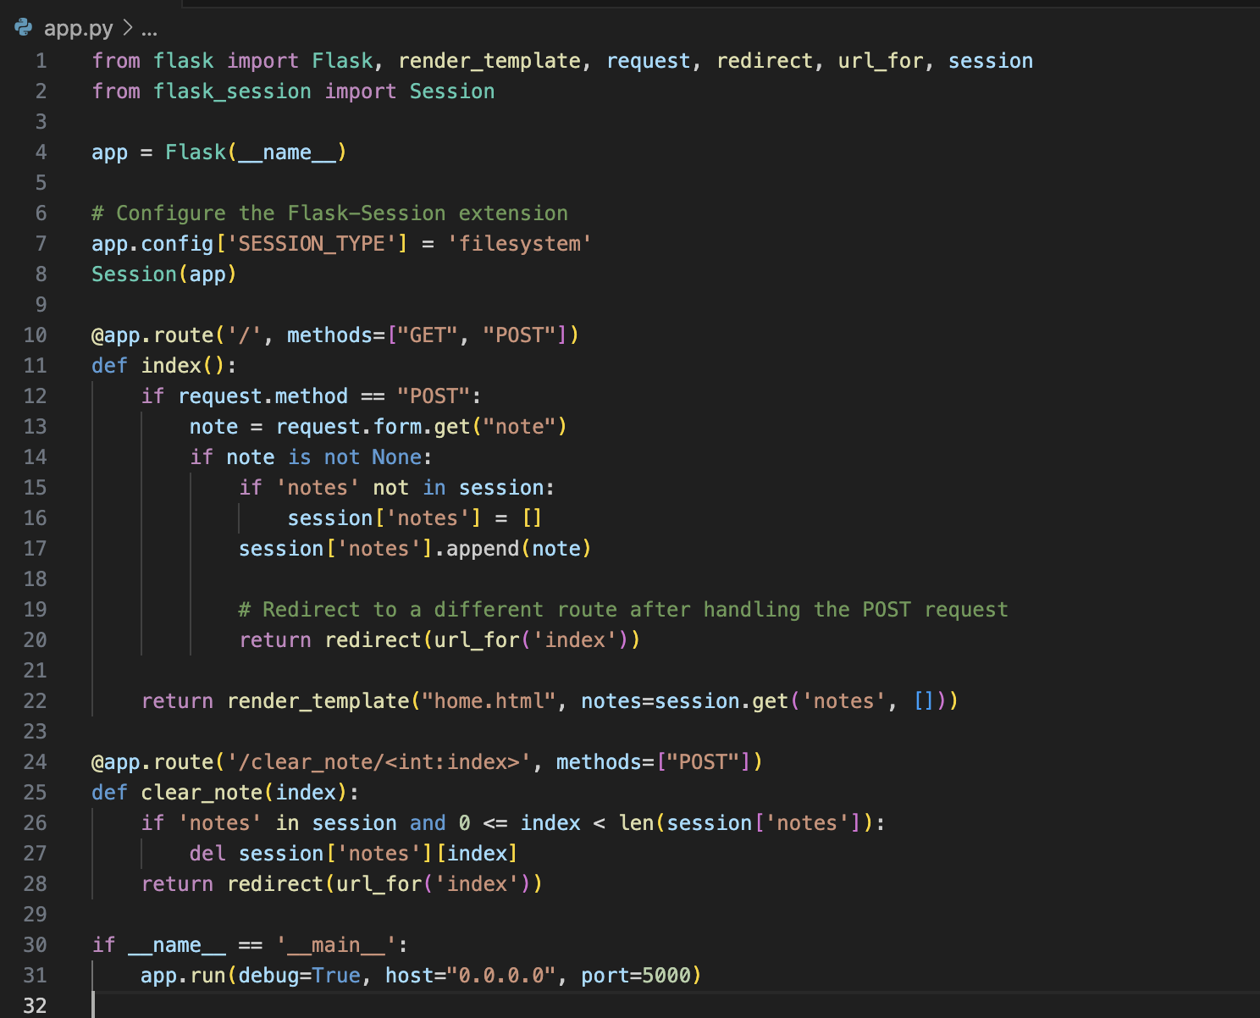
Final code (app.py) after debugging - Session Management

Slide 15
Session Management :
Flask-Session is to handle session management.
Configuring Flask-Session to use the 'filesystem' storage type. This means that session data will be stored on the server's filesystem.
In the index route, one can access the session using “session”. Check if the 'notes' key exists in the session, and if it does, retrieve the list of notes. This list is then passed to the 'home.html' template for rendering.
When a POST request is made (e.g., submitting a form), retrieve the note from the form data. If the 'notes' key doesn't exist in the session, initialize it as an empty list. Then append the new note to the session's 'notes' list.

Slide 16
Session Management :
In the clear_note route, remove a note at a specified index from the session's 'notes' list.
Overall, session management allows your Flask application to maintain user-specific data throughout the user's interaction with the web application, providing a way to store and retrieve information between different requests.

Slide 17
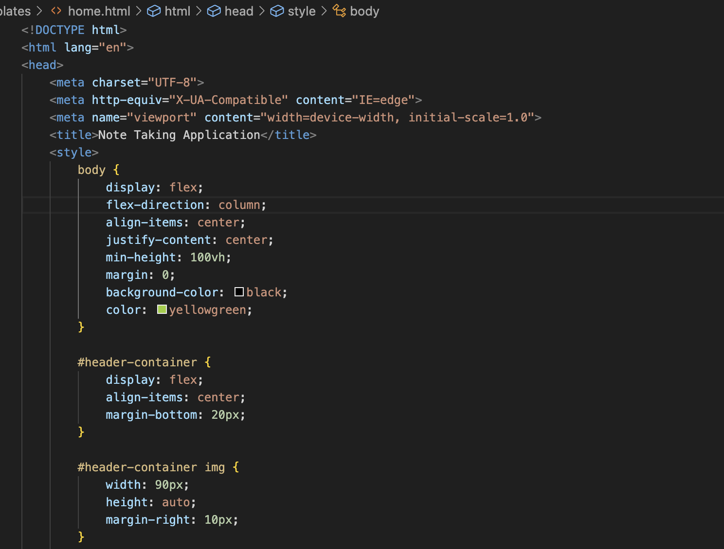
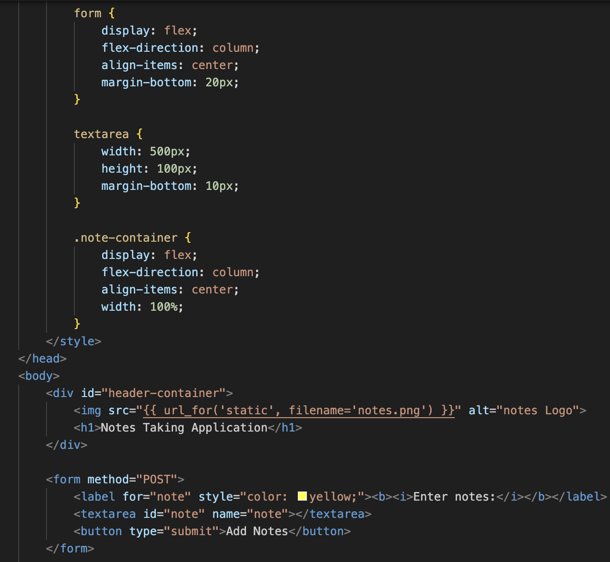
home.html (After debugging and styling):

Slide 18
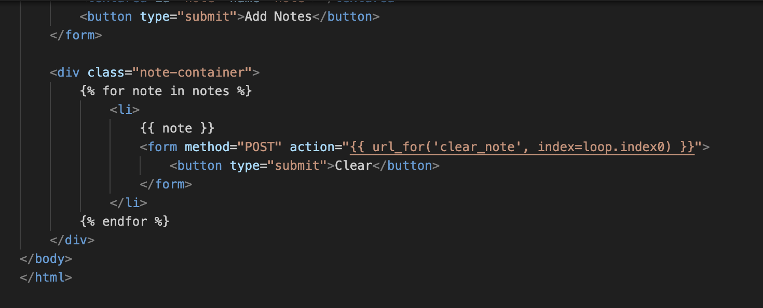
home.html (After debugging and styling):

Slide 19
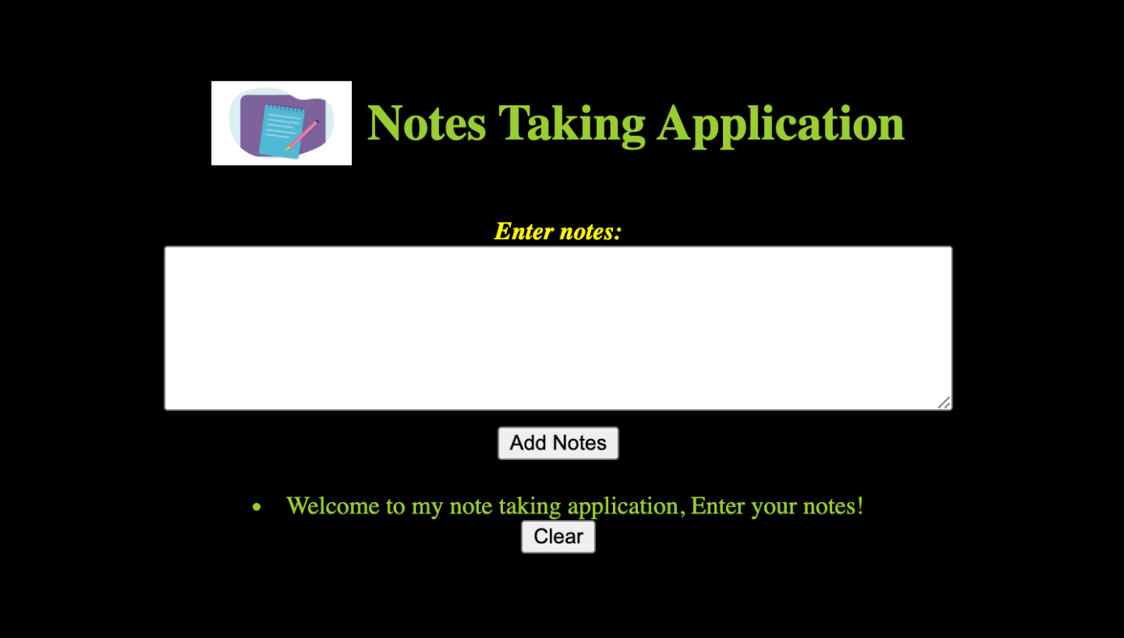
Final Application Output (after styling):

Slide 20
Conclusion:
Retrieving note from the form data for POST requests correctly, Handling the flask route action and methods to GET , POST resulted in proper functioning of the application.
Enhancing the UI of the application.

Slide 21

THANK YOU

